Slide 1
An overview of Inferential Statistics
Topics to be covered:
What is inferential statistics?
Distribution, Normal Distribution & Standard Normal Distribution
What is Standard Error?
Estimators & Estimates
What is Central limit Theorem?
Sehrish Aqeel
www.aisciences.io

Slide 2
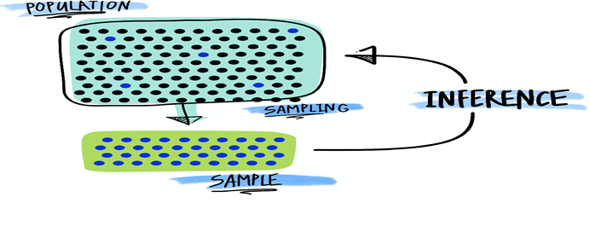
Inferential Statistics
It deals with procedures for making inferences about characteristics that describes the larger group of data (population).
Inferential statistics consists of techniques for reaching conclusions about a population based upon information contained in a sample.

Slide 3
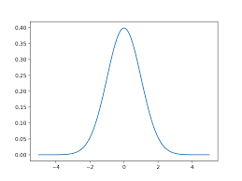
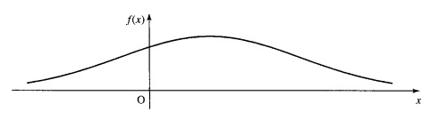
The Normal Distribution
The normal distribution is symmetric about its mean. It is bell-shaped and the fatness of the bell depends on its standard deviation.

Slide 4
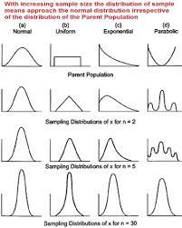
Standard Normal Distribution
The standard normal distribution, also called the z-distribution, is a special normal distribution where the mean is 0 and the standard deviation is 1.
Any normal distribution can be standardized by converting its values into z-scores.
Z-scores tell you how many standard deviations from the mean each value lies.

Slide 5
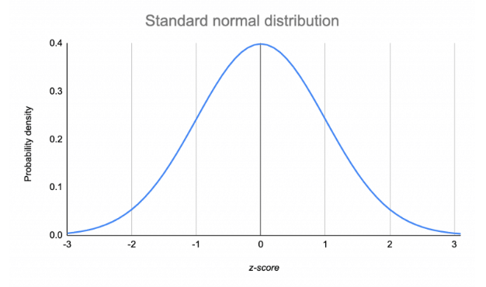
Standard Normal Distribution

Slide 6
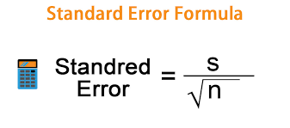
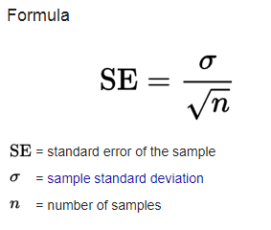
Standard Error
The standard error (SE) of a statistic is the standard deviation of its sampling distribution or an estimate of that standard deviation.

Slide 7


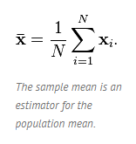
Estimator and Estimates
An estimator is a statistic that estimates some fact about the population. You can also think of an estimator as the rule that creates an estimate.
For example, the sample mean(x̄) is an estimator for the population mean, μ.

Slide 8

Estimator and Estimates
The quantity that is being estimated (i.e. the one you want to know) is called the estimand.
For example, let’s say you wanted to know the average height of children in a certain school with a population of 1000 students. You take a sample of 30 children, measure them and find that the mean height is 56 inches. This is your sample mean, the estimator. You use the sample mean to estimate that the population mean (your estimand) is about 56 inches.

Slide 9
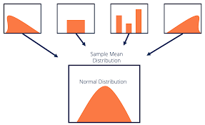
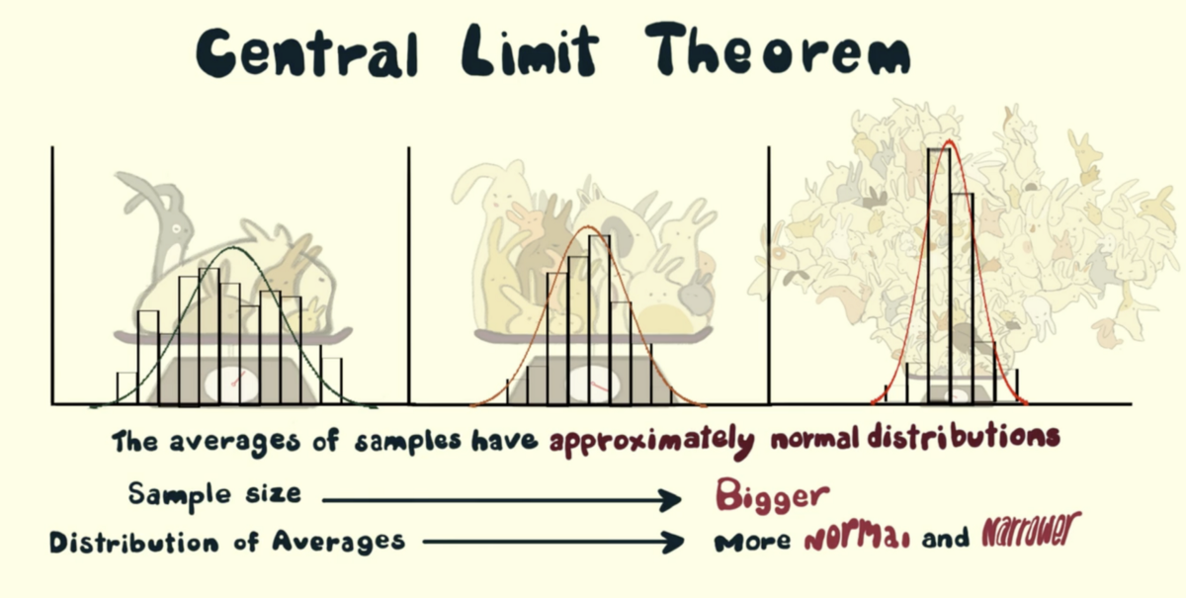
Central Limit Theorem
The central limit theorem states that if you have a population with mean μ and standard deviation σ and take sufficiently large random samples from the population with replacement, then the distribution of the sample means will be approximately normally distributed.

Slide 10
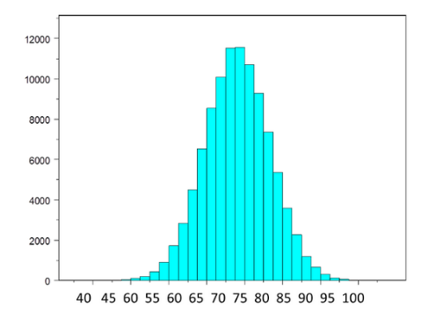
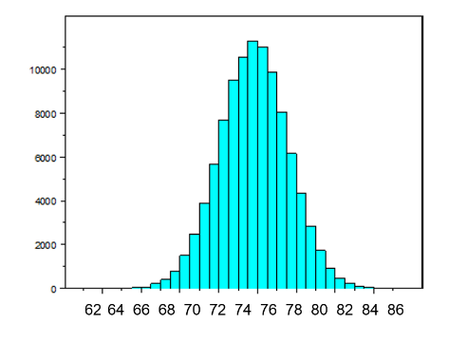
Central Limit Theorem

